Slide 1
Spring Enterprise Framework
Appreciating All Levels From Surface to Depth

Slide 2
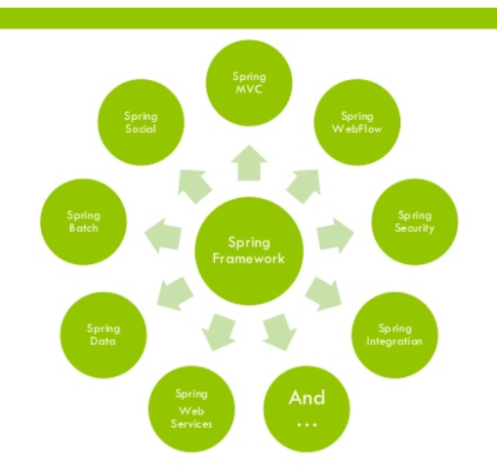
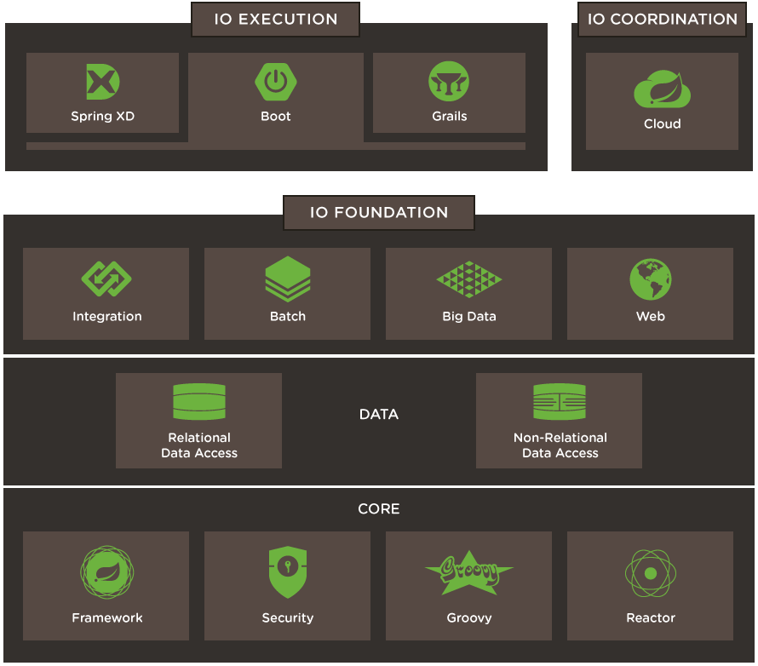
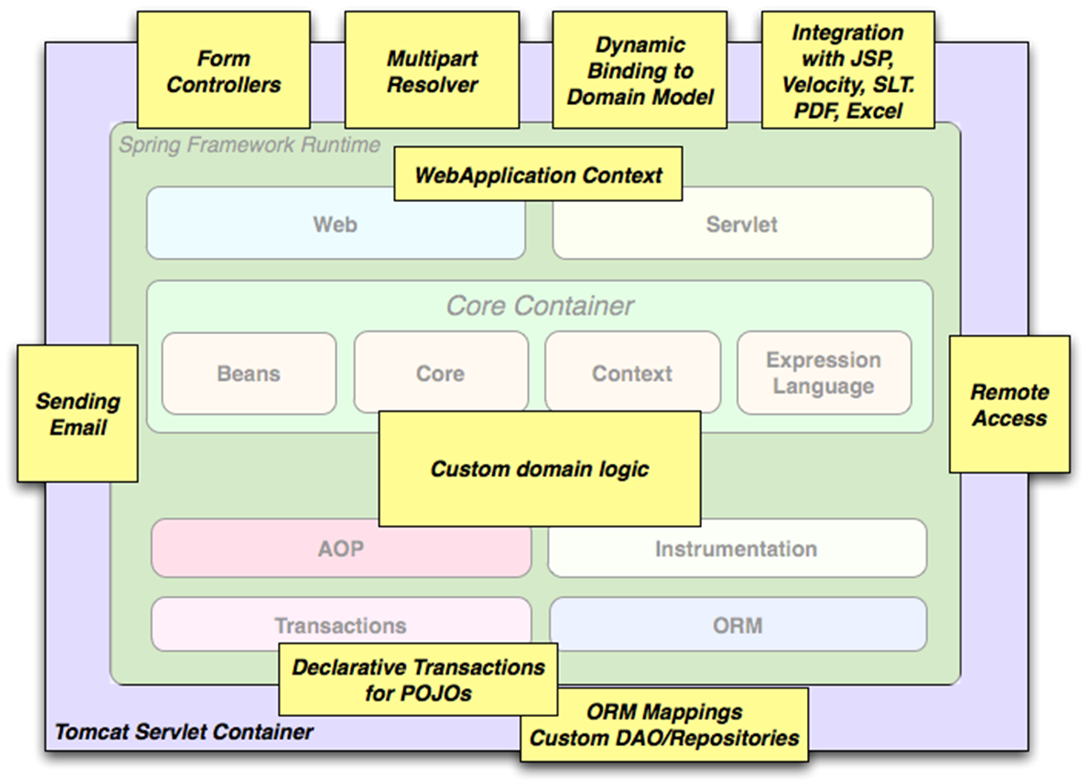
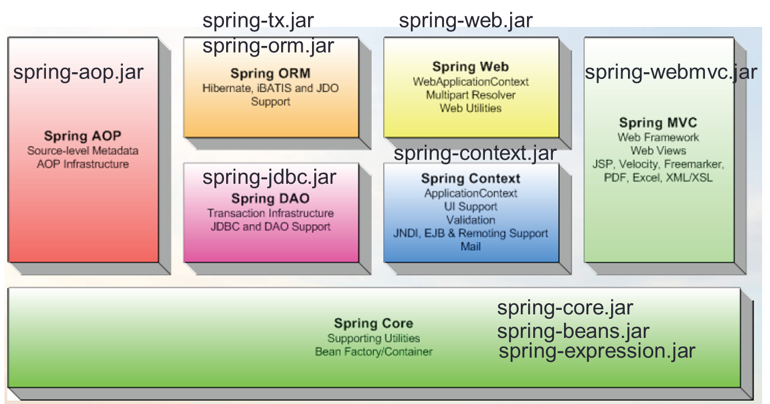
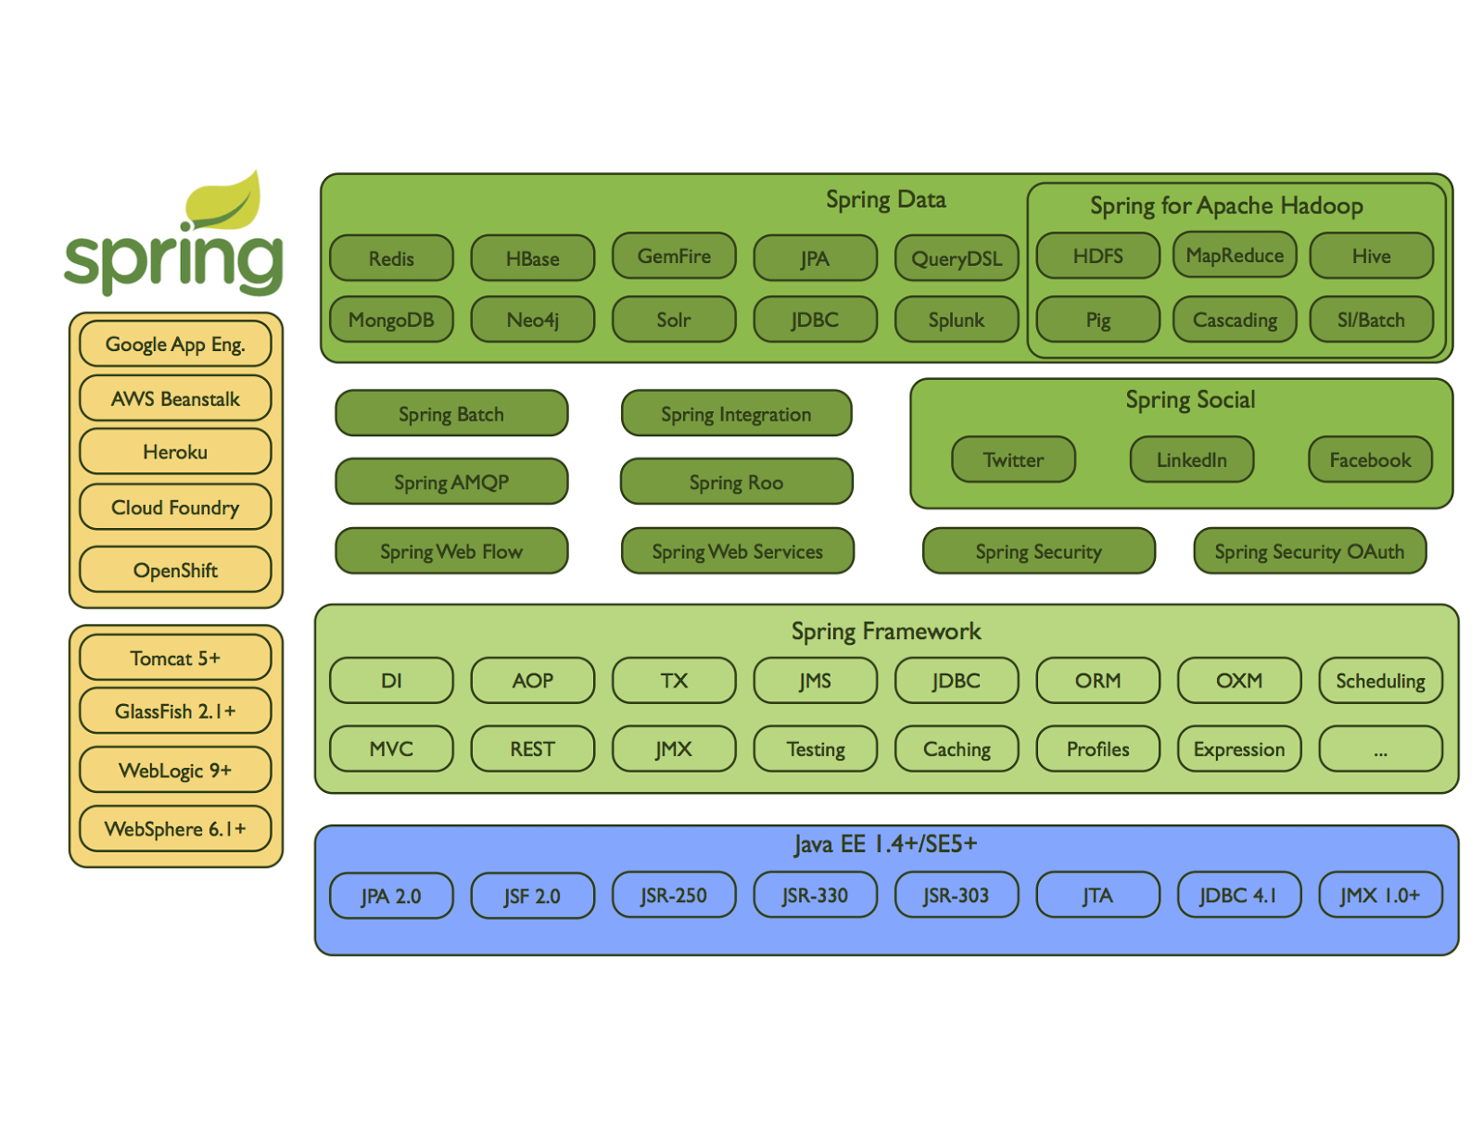
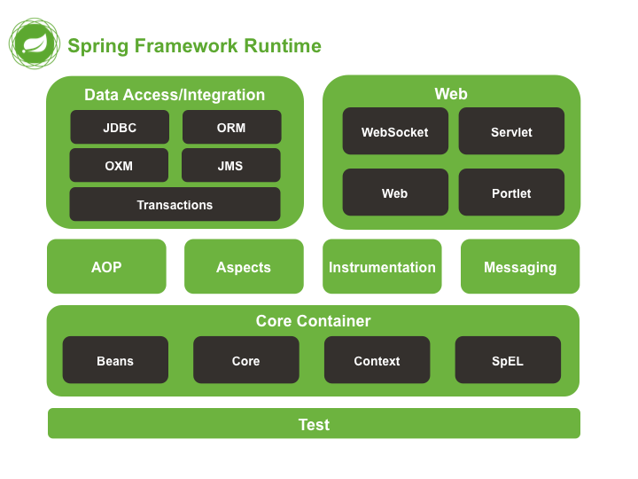
Notes:
Project Reactor – WebFlux - reactive streams
Groovy is a powerful, optionally typed and dynamic language, for the Java platform with a concise, familiar and easy to learn syntax. Run time generation of class/object
Grails -- Convention-over-configuration, sensible defaults, opinionated APIs, and the Groovy language
Spring XD -- Cloud based Big Data…replaced by Cloud Data Flow

Slide 3
Spring Framework
Infrastructure support for developing Java applications.
Configure disparate components into a fully working application ready for use.
Build applications from “plain old Java objects” (POJOs)
Non-intrusive - domain logic has little or no dependencies on framework
Lightweight application model is that of a layered [N-tier] architecture. Spring 3 Tiers:
Presentation objects such as Spring MVC controllers are typically configured in a distinct presentation context[tier]
Service objects, business-specific objects, etc. exist in a distinct business context[tier]
Data access objects exist in a distinct persistence context[tier]

Slide 4
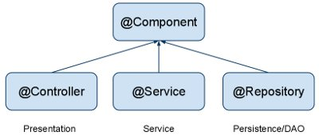
Backend Components
@Component is a generic stereotype for any Spring-managed component. @Repository, @Service, and @Controller are specializations of @Component for more specific use cases, for example, in the persistence, service, and presentation layers, respectively.

Slide 5
Annotate based on Function
OPTION - annotate all your component classes with @Component
Using @Repository, @Service, and @Controller is:
  Better suited for processing by tools
    @Repository - automatic translation of exceptions
    @Controller – rich set of framework functionality
    @Service – “home” of @Transactions
  More properly suited for associating with aspects
  May carry additional semantics in future releases of the Spring Framework.

Slide 6
Service Layer
Issue: not whether or not it is needed
BUT
What it contains

Slide 7
Domain Driven Design
Primary focus - the core domain and domain logic.
Complex designs based on a model of the domain.
Collaboration between technical and domain experts to iteratively refine a conceptual model that addresses particular domain problems.
GOAL: a Rich Domain Model

Slide 8
“Thin” Domain Model
Contains objects properly named after the nouns in the domain space
Objects are connected with the rich relationships and structure that true domain models have.
Extreme case: Anemic Domain Model
Little or no behavior – bags of getters and setters.

Slide 9
Service Layer
In a perfect world:
“Thin Layer”
With
“Rich Domain Model”
No business rules or knowledge
Coordinates tasks
Delegates work to domain objects
“The Reality”
Quite often additional “Domain” Services exist - populated with “externalized” Business/Logic rules.

Slide 10
Service Component Use Cases
See Service Component use cases.docx

Slide 11
Main Point
An N Tier Architecture separates an application into layers thereby supporting a separation of concerns making any application more efficient, modular and scalable.
Life is structured in layers. It is a structure that is both stable and flexible, consistent yet variable and it encompasses an infinite range of possibilities

Slide 12
A Good Framework
Designed to simplify development
    Has already been built, tested, and industry hardened
    Increases reliability and reduces programming time
    Adheres to DRY principle
    Helps enforce best practices and rules
    Standards Based
    Design Pattern based

Slide 13
Spring Framework
Based on Java Standards
JSR 330: Dependency Injection for Java
JSR-250 Common Annotations for the JavaTM Platform
JSR-107 Annotations
JSR-303 - 349 Validation
JSR-352 Batch
JSR-107 JCache annotations
JSR-299 @Decorator and @Delegate
JSR-160 Connectors
JSR 286 Portlets

Slide 14
Spring Framework
Based on Design Patterns
Factory
Proxy
Singleton
MVC
Front Controller
Template method
Adapter
Decorator
Observer
Interpreter
Builder
Factory method
Abstract factory
Composite
Strategy
Prototype
Object pool
Facade
Notes:
http://www.waitingforcode.com/spring-framework/design-patterns-in-spring-framework-part-1/read
Interpreter SPEL
Strategy -- algorithmns

Slide 15
Current Course [CS 544] Context
Coming Events
What we’ve Accomplished

Slide 16
Additional Coming Events
Notes:
XD big Data …. REACTOR non-blocking IO – Node.js …
Groovy aimed at improving developer productivity thanks to a concise, familiar and easy to learn syntax. It integrates smoothly with any Java program…scripting capabilities
The key defining feature of a dynamic language is that entire language is available at all times. This means you can execute code at compile-time, and compile code at execution time. This, combined with other features (first class functions, introspection) enables Metaprogramming, programs that can modify themselves.
Grails Groovy Web Framework

Slide 17
Main Point
Frameworks make development easier and more effective by providing a secure and reliable foundation on which to build upon.
The simplest form of awareness, Transcendental Consciousness, provides a strong foundation for a rewarding and successful life.

